Slide 1
GCBASIC
PIC18FxxQ35chip Family
Part 9 - Timers and Timer Interrupts

Slide 2

GCBASIC
PIC18FxxQ35chip Family
Part 9 - Timers and Timer Interrupts

Slide 3
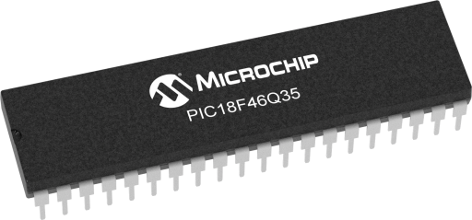
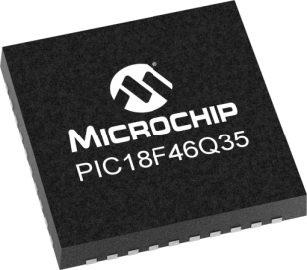
GCBASIC
Like and subscribe!

Slide 4
PIC18FxxQ35
PIC18FxxQ35 is a high performance PIC18
Digital and analog peripherals for flexible embedded control
10-bit ADC for accurate analog signal conversion
Multiple communication interfaces including UART (serial), I²C, and SPI
PWM modules with CCP and 16-bit resolution for precise timing and motor control
Configurable Logic Cells (CLCs) for custom hardware-level logic without external components
Integrated op amps for onboard analog signal conditioning and amplification
The PIC18FxxQ35 offers 28, 40 and 44-pin products in small footprint packages to support customers in a wide variety of applications.

Slide 5
Videos...
Install the hardware and make the board work – make LEDs work
Make four LEDs flash in a sequence
Set the LEDs to represent the value of ADC
Sequence the LEDs with a delay using the value of ADC
Using an input to set the state of the LEDs
Using the reset switch
Using the switch, ADC – make the LEDs flash in a sequence with reverse
Using the serial to display values
Using the timer0 overflow, 8bit timer, 16bit timer to flash the LEDs
Using EEProm – showing values on the serial terminal, and more constants insights
Using I2C with serial to discover I2C devices
Using an I2C GCLD display
Using a SPI GCLD display
Using PWM, many ways, to dim the LEDS
Using an external interrupt to control an LED
Using storage within the chip – Progmem, SAF memory, EEPROM and DATA blocks
Using CLC
The GCBASIC tool chain
Assembly , alternatives assemblers and MPLAB-X
Summary

Slide 6
GCBASIC Compiler
GCBASIC Compiler
GCBASIC is an Open Source compiler for PIC, AVR and LGT microcontrollers
GCBASIC now supports the 18FxxQ35 chip family
GCBASIC now supports 1400+ microcontrollers

Slide 7
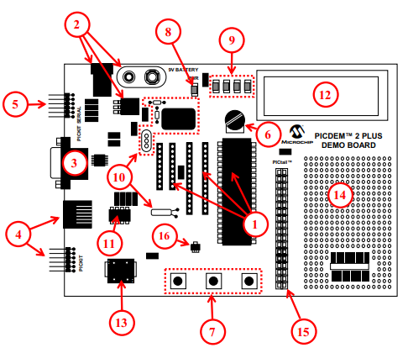
PICDEM 2 Plus Demonstration
Board
1. 18-, 28- and 40-pin DIP sockets
(although three sockets are provided, only one device may be used at a time)
2. On-board, +5V regulator for direct input from 9V, 100 mA AC/DC wall adapter or 9V battery, or hooks for a +5V, 100 mA regulated DC supply
3. RS-232 socket and associated hardware for direct connection to an RS-232 interface
4. Programmer/debugger connectivity supporting MPLAB® ICD 3, MPLAB REAL
ICE and PICkit 3
5. PICkit Serial Connector for analysis of serial communications peripherals such as SPI or I2C™
6. 5 k pot for devices with analog inputs
7. Three push button switches for external stimulus and Reset
8. Power-on indicator LED
9. Four LEDs connected to PORTB
10. On-board external oscillators including:
a) Unpopulated DIP socket for canned crystal oscillator (Y2)
b) RC oscillator circuit (R4, C3)
c) Unpopulated holes for crystal connection (Y1)
d) 32.768 kHz crystal for Timer1 clock operation (Y3) 11. 32K x 8 Serial EEPROM
12. LCD display
13. Piezo buzzer
14. Prototype area for user hardware
15. Expansion Header for PICtail™ daughter card connectivity or user access to
MCU pins
16. Microchip TC74 thermal sensor
3A

Slide 8
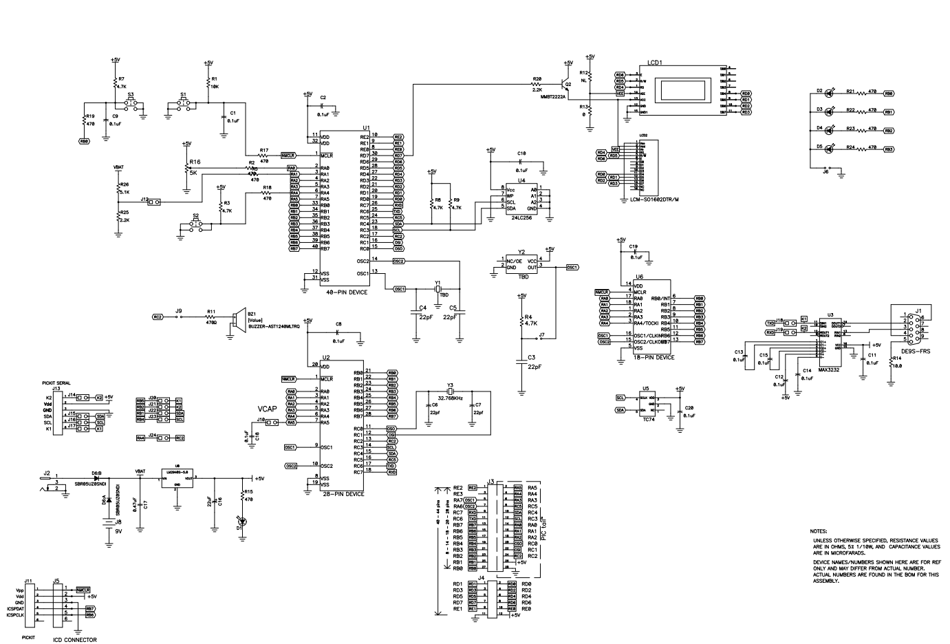
PICDEM 2 Plus Demonstration
Board

Slide 9
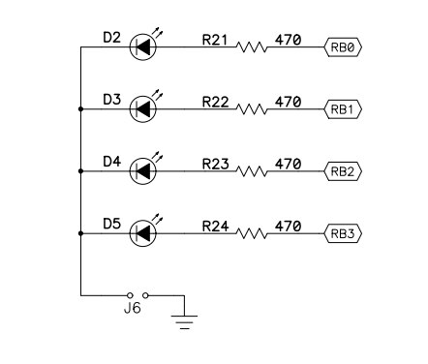
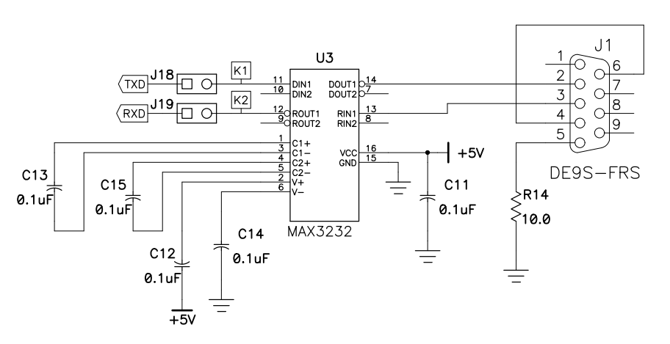
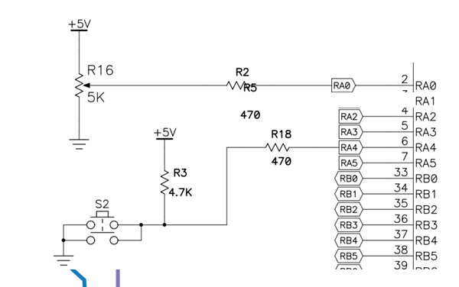
Schematic
USART TTL SIGNAL

Slide 10
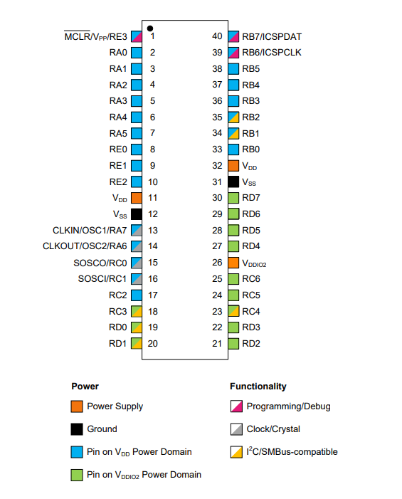
VDDIO2 Domain Power
Think No VDDIO2 power – no domain I/O!

Slide 11
Timer Primer

Slide 12
Timer Block Diagram
Timers generate the accurate time delays. The microcontroller can also generate/measure the required time delays by running loops, in your program, but the timer/counter relieves the CPU from that operation by using the prescalar and postscalar A timer is nothing but a simple binary counter that can be configured to count clock pulses(Internal/External). A register increments from a specific value. Once it reaches the maximum value, it will roll back to zero setting up an OverFlow flag and generates the interrupt ... if enabled.

Slide 13
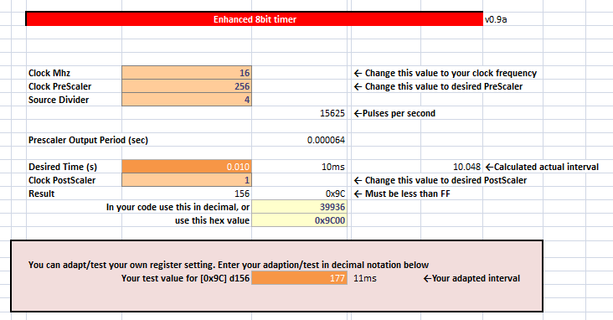
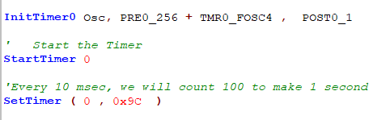
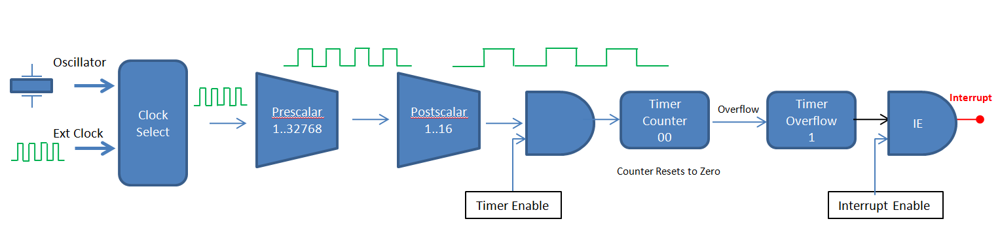
Timer Overview

Slide 14
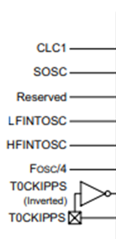
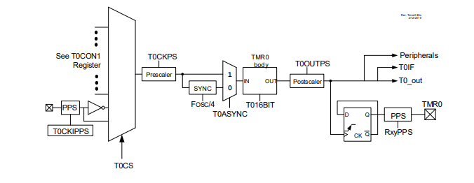
Timer0 block diagram

Slide 15
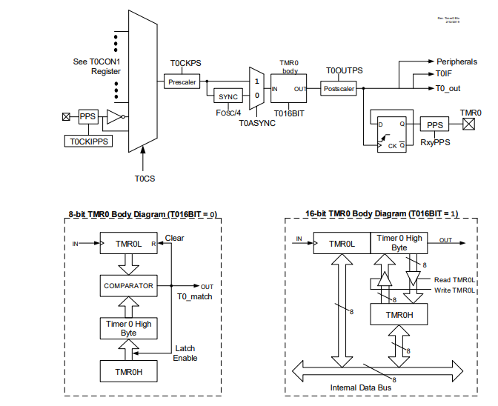
Timer0 block diagram

Slide 16
Timer0 block diagram

Slide 17
Timer Block Diagram
Oscillator
Clock Select
Prescalar
1..32768
Postscalar
1..16
Interrupt
Timer Counter nn..FF.00
Overflow
Timer Overflow
IE
Ext Clock
Counter Resets to Zero
Timer Enable
Interrupt Enable
Timers generate the accurate time delays. The microcontroller can also generate/measure the required time delays by running loops, in your program, but the timer/counter relieves the CPU from that operation by using the prescalar and postscalar A timer is nothing but a simple binary counter that can be configured to count clock pulses(Internal/External). A register increments from a specific value. Once it reaches the maximum value, it will roll back to zero setting up an OverFlow flag and generates the interrupt ... if enabled.

Slide 18
Timer Block Diagram
Oscillator
Clock Select
Ext Clock

Slide 19
Timer Block Diagram
Oscillator
Clock Select
Ext Clock

Slide 20
Timer Block Diagram
Oscillator
Clock Select
Prescalar
1..32768
Ext Clock

Slide 21
Timer Block Diagram
Oscillator
Clock Select
Prescalar
1..32768
Ext Clock

Slide 22
Timer Block Diagram
Oscillator
Clock Select
Prescalar
1..32768
Postscalar
1..16
Ext Clock

Slide 23
Timer Block Diagram
Oscillator
Clock Select
Prescalar
1..32768
Postscalar
1..16
Ext Clock

Slide 24
Timer Block Diagram
Oscillator
Clock Select
Prescalar
1..32768
Postscalar
1..16
Ext Clock
Timer Enable

Slide 25
Timer Block Diagram
Oscillator
Clock Select
Prescalar
1..32768
Postscalar
1..16
Timer Counter B1
Timer Overflow
0
Ext Clock
Set timer value
Timer Enable

Slide 26
Timer Block Diagram
Oscillator
Clock Select
Prescalar
1..32768
Postscalar
1..16
Timer Counter B1
Timer Overflow
0
Ext Clock
Timer Enable

Slide 27
Timer Block Diagram
Oscillator
Clock Select
Prescalar
1..32768
Postscalar
1..16
Timer Counter B2
Timer Overflow
0
Ext Clock
Timer Enable

Slide 28
Timer Block Diagram
Oscillator
Clock Select
Prescalar
1..32768
Postscalar
1..16
Timer Counter B3
Timer Overflow
0
Ext Clock
Timer Enable

Slide 29
Timer Block Diagram
Oscillator
Clock Select
Prescalar
1..32768
Postscalar
1..16
Timer Counter
..
Timer Overflow
0
Ext Clock
Timer Enable

Slide 30
Timer Block Diagram
Oscillator
Clock Select
Prescalar
1..32768
Postscalar
1..16
Timer Counter FE
Timer Overflow
0
Ext Clock
Timer Enable

Slide 31
Timer Block Diagram
Oscillator
Clock Select
Prescalar
1..32768
Postscalar
1..16
Timer Counter FF
Timer Overflow
0
Ext Clock
Timer Enable

Slide 32
Timer Block Diagram
Oscillator
Clock Select
Prescalar
1..32768
Postscalar
1..16
Timer Counter 00
Timer Overflow
0
Ext Clock
Counter Resets to Zero
Timer Enable

Slide 33
Timer Block Diagram
Oscillator
Clock Select
Prescalar
1..32768
Postscalar
1..16
Timer Counter 00
Overflow
Timer Overflow
1
Ext Clock
Counter Resets to Zero
Timer Enable

Slide 34
Timer Block Diagram
Oscillator
Clock Select
Prescalar
1..32768
Postscalar
1..16
Timer Counter 00
Overflow
Timer Overflow
1
Ext Clock
Counter Resets to Zero
Timer Enable

Slide 35
Timer Block Diagram
Oscillator
Clock Select
Prescalar
1..32768
Postscalar
1..16
Timer Counter 00
Overflow
Timer Overflow
1
IE
Ext Clock
Counter Resets to Zero
Timer Enable
Interrupt Enable

Slide 36
Timer Block Diagram
Oscillator
Clock Select
Prescalar
1..32768
Postscalar
1..16
Interrupt
Timer Counter 00
Overflow
Timer Overflow
1
IE
Ext Clock
Counter Resets to Zero
Timer Enable
Interrupt Enable

Slide 37
Lab
Examine the sample code
Review the results
Timer0 Overflow
8 Bit timer
16 Bit timer

Slide 39
Videos...
Install the hardware and make the board work – three LED programs
Make four LEDs flash in a sequence
Set the LEDs to represent the value of ADC
Sequence the LEDs with a delay using the value of ADC
Using an input to set the state of the LEDs
Using the reset switch
Using the switch, ADC – make the LEDs flash in a sequence with reverse
Using the serial to display values
Using the timer0: 16bit timer, 8bit timer and overflow to flash the LEDs
Using EEProm – showing values on the serial terminal, and more constants insights
Using I2C with serial to discover I2C devices
Using an I2C GCLD display
Using a SPI GCLD display
Using PWM, many ways, to dim the LEDS
Using an external interrupt to control an LED
Using storage within the chip – Progmem, SAF memory, EEPROM and DATA blocks
Using CLC
The GCBASIC tool chain
Assembly , alternatives assemblers and MPLAB-X
Summary

Slide 40
GCBASIC
PIC18FxxQ35chip Family
Part 9 - Timers and Timer Interrupts

